Slide 1
Recurrent Networks
(Hopfield)
by
Greg
JST - Hopfield Network

Slide 2
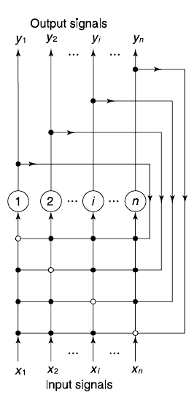
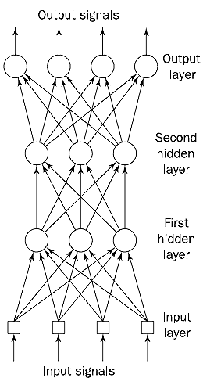
Feed Forward NN vs Recurrent NN
JST - Hopfield Network

Slide 3
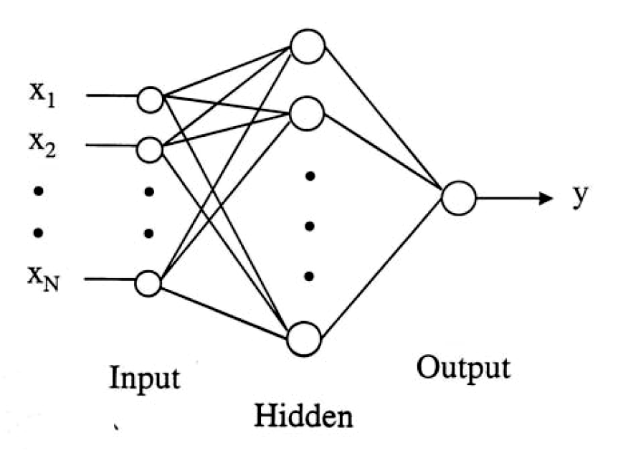
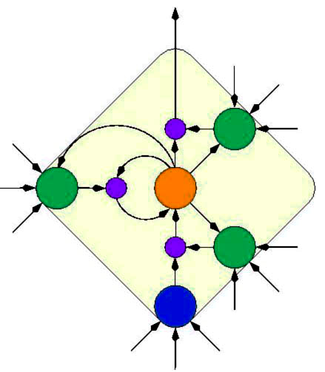
Network Structures
Feedforward NNs
  The connections between units do not form cycles.
  Usually produce a response to an input quickly.
  Most feedforward NNs can be trained using a wide variety of efficient algorithms.
Feedback or recurrent NNs
  There are cycles in the connections.
  In some feedback NNs, each time an input is presented, the NN must iterate for a potentially long time before it produces a response.
  Usually more difficult to train than feedforward NNs.
JST - Hopfield Network
Notes:
There are two major network structures using these units.
The first one is a feed-forward network.
It’s just an arbitrary function of its current inputs.
And there is no internal state other than weights.
The second one is a recurrent network.
This kind of network feeds its outputs back into its own inputs.
This structure can support a short-term memory.
But it’s rather difficult to understand.

Slide 4
The equivalence between layered, feedforward nets and recurrent nets
w1 w2
time=3
w1 w2
w3 w4
w3 w4
time=2
Assume that there is a time delay of 1 in using each connection.
The recurrent net is just a layered net that keeps reusing the same weights.
w1 w2
w3 w4
time=1
w1 w2
w3 w4
time=0
JST - Hopfield Network

Slide 5
Types of Learning
Supervised learning
given a set of pre-classified examples, learn a concept description which encapsulates the information in these examples and can be used predictively
i.e. the algorithm is provided with a set of examples (training set) of proper behaviour: {p₁,t₁}, {p₂,t₂},…,{p_{n},t_{n}}
  p_{i} - input
  t_{i} - corresponding (target) output
  classification - predict the class of unseen examples
  numeric prediction - predict not a discrete class but a numeric value
Success can be measured on fresh data for which class labels are known (test data)
JST - Hopfield Network

Slide 6
Types of Learning
Reinforcement learning
each example has a score (grade) instead of correct output
much less common that supervised learning
most suited to control systems applications
Unsupervised learning
given a collection of unclassified data, search for regularities.
  Create an internal representation of the input then extract features.
no target outputs, only inputs are available: p₁, p₂, …, p_{n}
The classifier learns to categorize (cluster) the input patterns into a finite number of classes
JST - Hopfield Network

Slide 7
Supervised-Learning NNs
Feedforward NNs
  Perceptron
  Adaline, Madaline
  Backpropagation (BP)
  Artmap
  Learning Vector Quantization (LVQ)
  Probabilistic Neural Network (PNN)
  General Regression Neural Network (GRNN)
Feedback or recurrent NNs
  Brain-State-in-a-Box (BSB)
  Fuzzy Congitive Map (FCM)
  Boltzmann Machine (BM)
  Backpropagation through time (BPTT)
JST - Hopfield Network

Slide 8
Unsupervised-Learning NNs
Feedforward NNs
  Learning Matrix (LM)
  Sparse Distributed Associative Memory (SDM)
  Fuzzy Associative Memory (FAM)
  Counterprogation (CPN)
Feedback or Recurrent NNs
  Binary Adaptive Resonance Theory (ART1)
  Analog Adaptive Resonance Theory (ART2, ART2a)
  Hopfield Network (H)
  Bidirectional Associative Memory (BAM)
  Kohonen Self-organizing (SOM)
JST - Hopfield Network

Slide 9
Associative Memories
An associative memory is a content-addressable structure that maps a set of input patterns to a set of output patterns.
Two types of associative memory:
Auto-association
  retrieves a previously stored pattern that most closely resembles the current pattern.
Hetero-association
  the retrieved pattern is, in general, different from the input pattern not only in content but possibly also in type and format.
JST - Hopfield Network

Slide 10
Associative Memories
Auto-association
A
A
memory
Hetero-association
Niagara
memory
Waterfall
JST - Hopfield Network

Slide 11
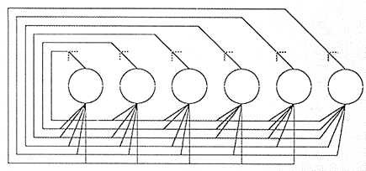
The Hopfield NNs
In 1982, Hopfield, a Caltech physicist, mathematically tied together many of the ideas from previous research.
A fully connected, symmetrically weighted network where each node functions both as input and output node.
JST - Hopfield Network

Slide 12
The Hopfield Network
The Hopfield model is a single-layered recurrent network.
It is usually initialized with appropriate weights instead of being trained.
The network structure looks as follows:
X₁
X₂
…
X_{N}
JST - Hopfield Network

Slide 13
The Hopfield Network
w_{1n}
w_{2n}
w_{3n}
w₁₃
w₂₃
w_{n3}
w₁₂
w₃₂
w_{n2}
w₂₁
w₃₁
w_{n1}
. . .
1
2
3
n
x₁
x₂
x₃
x_{n}
y₁
y₂
y₃
y_{n}
JST - Hopfield Network

Slide 14
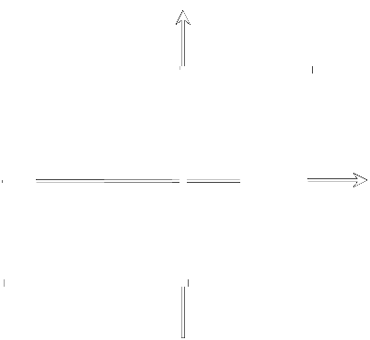
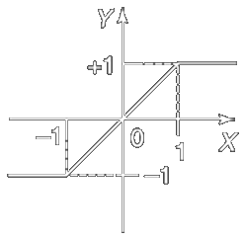
The Hopfield Network
Activation Function
  Sign Function
  Saturated Linear Function
JST - Hopfield Network

Slide 15
The Hopfield Network Training Algorithm
Step 1: Storage
The n-neuron Hopfield network is required to store a set of M fundamental memories*, Y₁, Y₂, . . . , Y_{M}.
The synaptic weight from neuron i to neuron j is calculated as:
where, y_{m,i} and y_{m,j} are the i^{th} and the j^{th} elements of the fundamental memory Y_{m}.
In matrix form, they are represented as:
(*) Fundamental Memory = Stable State ⇒ Learning Pattern
JST - Hopfield Network

Slide 16
The Hopfield Network Training Algorithm
The Hopfield network can store a set of fundamental memories if the weight matrix is symmetrical, with zeros in its main diagonal (Cohen and Grossberg, 1983). That is,
where, w_{ij} = w_{ji}.
Once the weights are calculated, they remain fixed.
JST - Hopfield Network

Slide 17
The Hopfield Network Training Algorithm
Step 2: Testing
The hopfield network must recall any fundamental memory Y_{m} when presented with it as an input. That is,
x_{m,i} = y_{m,,j}, i = 1, 2, . . . , n; m = 1, 2, . . . , M
where, y_{m,i} is the i^{th} element of the actual output vector Y_{m}, and x_{m,j} is the j^{th} element of the input vector X_{m}.
In matrix form:
X_{m} = Y_{m}, m = 1, 2, . . . , M
Y_{m} = sign (WX_{m} - θ)
If all fundamental memories are recalled perfectly, the network is ready to use. Go to step 3.
JST - Hopfield Network

Slide 18
The Hopfield Network Training Algorithm
Step 3: Retreival
Present an unknown n-dimensional vector (probe), X, to the network and retrieve a stable state. (Typically, the probe represents a corrupted or incomplete version of the fundamental memory)
X ≠ Y_{m}, m = 1, 2, . . . , M
(a) Initialise the retrieval algorithm by setting
x_{j}(0) = x_{j}, j = 1, 2, . . . , n
and calculate the initial state for each neuron
where, x_{j}(0) is the j^{th} element of the probe vector X at iteration p = 0, and y(0) is the state of neuron i at iteration p = 0.
In matrix form:
Y(0) = sign[WX(0) - θ]
JST - Hopfield Network

Slide 19
The Hopfield Network Training Algorithm
(b) Update the elements of the state vector, Y(p), according to the following rule:
Neurons for updating are selected asynchronously (randomly and one at a time) or synchronously.
(c) Repeat (b) until the state vector unchanged (stable state).
The condition for stability can be defined as:
In matrix form:
Y(p + 1) = sign[WY(p) - θ]
“The Hopfield network will always converge to a stable state if the retrieval is done asynchronously” (Haykin, 1999).
  The stable state (result) does not necessarily represent one of the fundamental memories,
  If it is a fundamental memory it is not necessarily the closest one.
JST - Hopfield Network

Slide 20
The Hopfield Network (Example)
Suppose, a network is required to memorise two opposite states, (1, 1, 1) and (-1, -1, -1)
Step 1: Storage
Determine The Weight Matrix
JST - Hopfield Network

Slide 21
The Hopfield Network (Example)
Step 2: Testing
Assume θ = 0
Y_{m} = sign (WX_{m} - θ)
NETWORK STABLE
√
√
JST - Hopfield Network

Slide 22
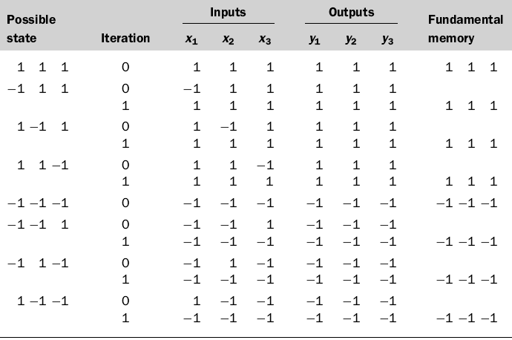
The Hopfield Network (Example)
Step 3: Retrieval (synchronous update)
JST - Hopfield Network

Slide 23
The Hopfield Network
Storage Capacity:
(Hopfield, 1982)
  M_{max} = 0.15n
  M_{max} = maximum number of fundamental memories that can be stored in the n-neuron
(Amit, 1989)
Can retrieve most of the fundamental memories perfectly
Can retrieve all of the fundamental memories perfectly
JST - Hopfield Network

Slide 24
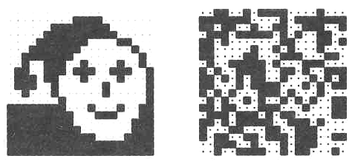
The Hopfield Network
Example: Image reconstruction (Ritter, Schulten, Martinetz 1990)
A 20×20 discrete Hopfield network was trained with 20 input patterns, including the one shown in the left figure and 19 random patterns as the one on the right.
JST - Hopfield Network

Slide 25
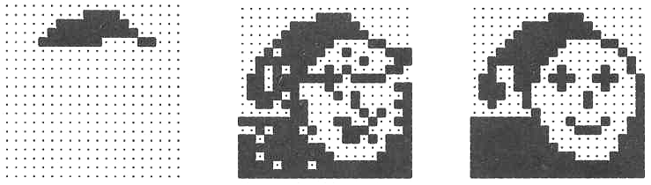
The Hopfield Network
After providing only one fourth of the “face” image as initial input, the network is able to perfectly reconstruct that image within only two iterations.
JST - Hopfield Network

Slide 26
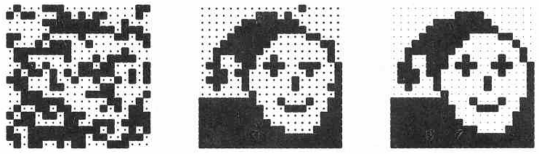
The Hopfield Network
Adding noise by changing each pixel with a probability p = 0.3 does not impair the network’s performance.
After two steps the image is perfectly reconstructed.
JST - Hopfield Network

Slide 27
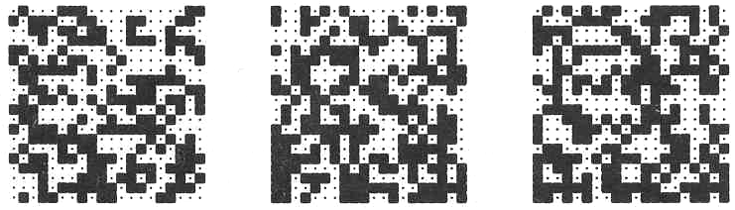
The Hopfield Network
However, for noise created by p = 0.4, the network is unable the original image.
Instead, it converges against one of the 19 random patterns.
JST - Hopfield Network

Slide 28
The Hopfield Network
The Hopfield model constitutes an interesting neural approach to identifying partially occluded objects and objects in noisy images.
(Error Correction Network)
These are among the toughest problems in computer vision.
JST - Hopfield Network

Slide 29
The Hopfield Network (Exercise)
Nilai Max: 10 point, kalau diprogram -> nilai 15.
Fundamental Memory:
X₁ = (+1, -1, +1, -1, +1, -1)
X₂ = (+1, -1, +1, +1, -1, +1)
X₃ = (-1, -1, +1, +1, -1, -1)
Hitunglah Weight Matrix-nya.
Untuk 2 pattern dibawah ini, hitunglah hasilnya sampai max 2 iterasi, bila belum juga stabil.
P1 = (-1, -1, +1, +1, -1, +1)
P2 = (+1, +1, -1, +1, +1, +1)
JST - Hopfield Network

